Slide 1
Convolutional Sparse Kronecker Product Decomposition (CSKPD), a Generalized Model for SKPD Regression, Applied to OASIS Data for Detection of Alzheimer’s
Joshua White
PhD Candidate in Big Data Analytics, University of Central Florida
MS in Statistics and Data Science, University of Central Florida, 2022
BS in Computational Mathematical Sciences, Arizona State University, 2019
Advisor: Dr. Hsin-Hsiung Huang

Slide 2
Introduction
Often decision making requires both statistical and human analysis to derive a proper conclusion.
This is the case in imaging data in which a physician needs to analyze the results prior to a diagnosis.
Bayesian methods are computationally expensive.
Machine Learning models do not provide any intuition to analyze the results.
CSKPD aims to be a method to provide intuition to human experts from high-dimensional data.

Slide 3
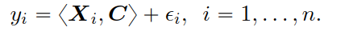
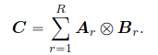
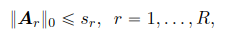
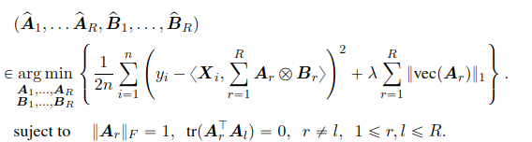
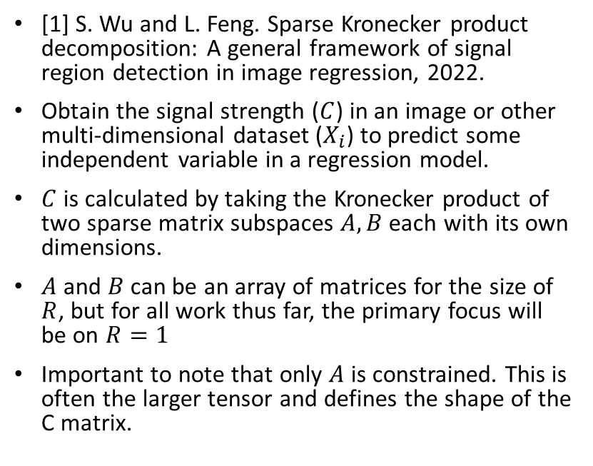
Introduction to SKPD
[1] S. Wu and L. Feng. Sparse Kronecker product decomposition: A general framework of signal region detection in image regression, 2022.
Obtain the signal strength ($C$) in an image or other multi-dimensional dataset ($X_{i}$) to predict some independent variable in a regression model.
$C$ is calculated by taking the Kronecker product of two sparse matrix subspaces $A,B$ each with its own dimensions.
$A$ and $B$ can be an array of matrices for the size of $R$, but for all work thus far, the primary focus will be on $R=1$
Important to note that only $A$ is constrained. This is often the larger tensor and defines the shape of the C matrix.

Slide 4
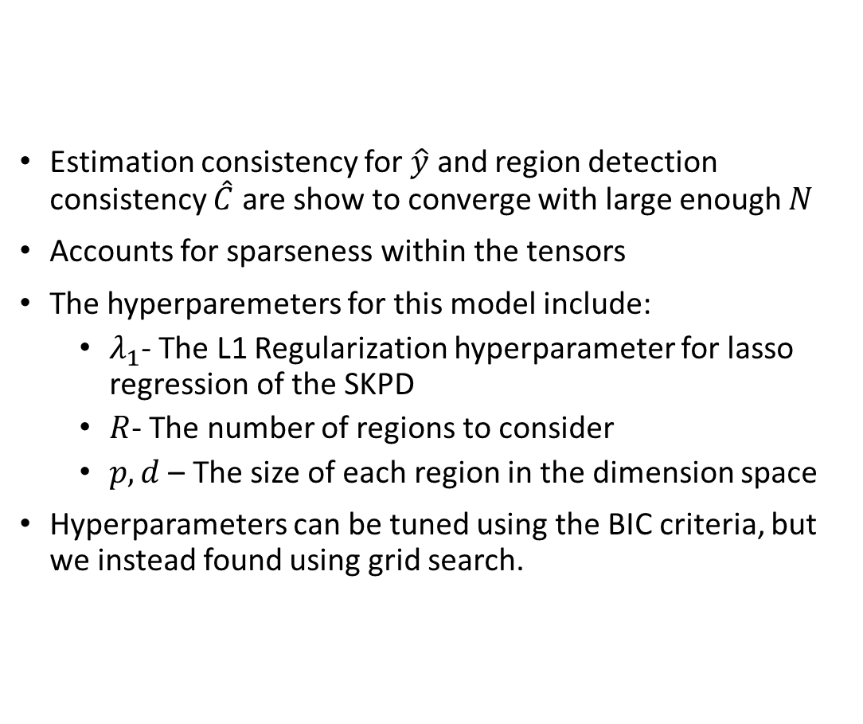
SKPD Continued
Estimation consistency for $\hat{y}$ and region detection consistency $\hat{C}$ are show to converge with large enough $N$
Accounts for sparseness within the tensors
The hyperparemeters for this model include:
$λ_{1}$- The L1 Regularization hyperparameter for lasso regression of the SKPD
$R$- The number of regions to consider
$p,d$ – The size of each region in the dimension space
Hyperparameters can be tuned using the BIC criteria, but we instead found using grid search.
Notes:
Include equation 30 in current, 31 in proposed method.

Slide 5
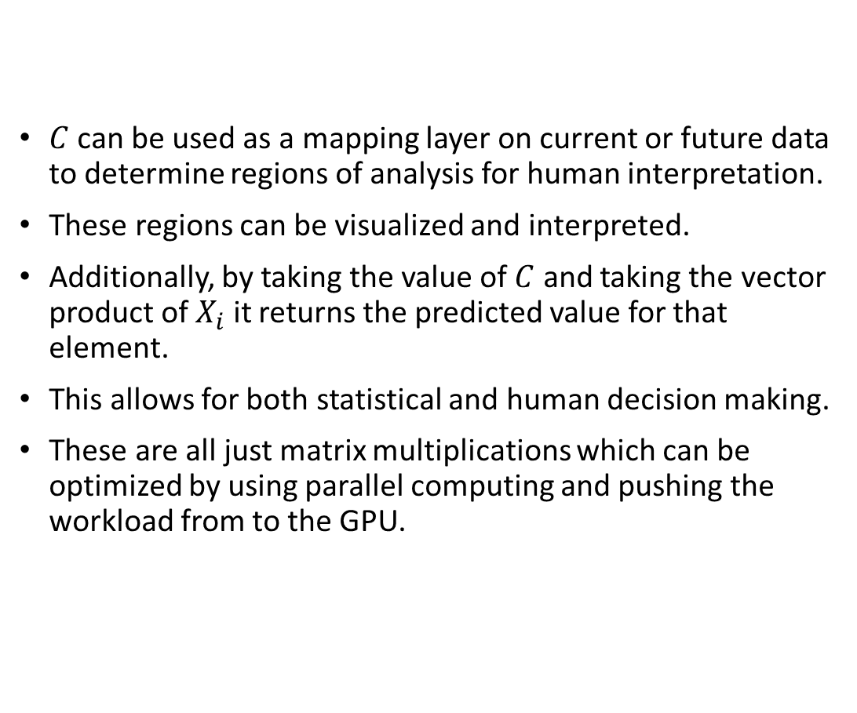
Methodology
$C$ can be used as a mapping layer on current or future data to determine regions of analysis for human interpretation.
These regions can be visualized and interpreted.
Additionally, by taking the value of $C$ and taking the vector product of $X_{i}$ it returns the predicted value for that element.
This allows for both statistical and human decision making.
These are all just matrix multiplications which can be optimized by using parallel computing and pushing the workload from to the GPU.

Slide 6
Observations of SKPD
Mentions that the model can be generalized but provides no theoretical or simulated framework to further extend the model.
SKPD describes overlap between SKPD and CNN, but considers region convolutions but not necessarily pixel/voxel convolutions.
SKPD allows for both L1 and L2 regularization. L1 appears to be more beneficial for C to eliminate the effect of some coefficients in the C matrix to reduce the dimension and identify regions more sharply.

Slide 7
Extension to CSKPD
There is room to leverage some of the pre-processing steps from CNN within the framework of the SKPD model.
As such the filtering component can be used similar to the convolutional components in CNN, but is reproducible
Convolutions can be used as part of a pre-processing step or within the model to model the behavior.
This leaves interpretable results that may be able to provide similar accuracy of CNN
The output can be seen on existing images to evaluate.

Slide 8
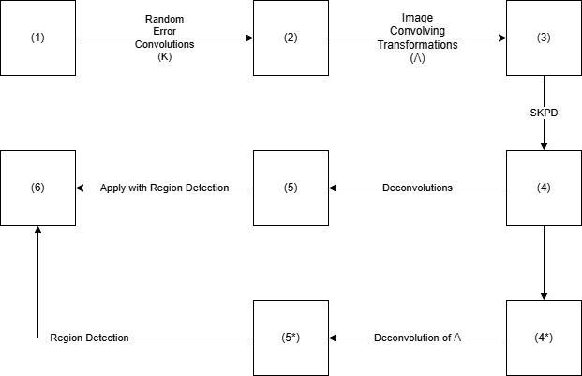
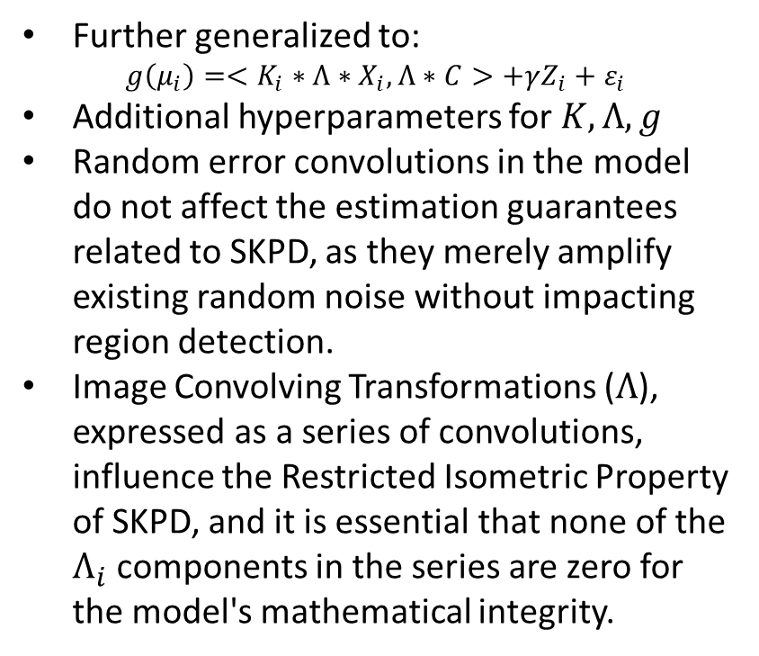
CSKPD Architecture
Further generalized to:
$$g\left(μ_{i}\right)=<K_{i}∗Λ∗X_{i},Λ∗C>+γZ_{i}+ε_{i}$$
Additional hyperparameters for $K, Λ,g$
Random error convolutions in the model do not affect the estimation guarantees related to SKPD, as they merely amplify existing random noise without impacting region detection.
Image Convolving Transformations ($Λ$), expressed as a series of convolutions, influence the Restricted Isometric Property of SKPD, and it is essential that none of the $Λ_{i}$ components in the series are zero for the model's mathematical integrity.

Slide 9
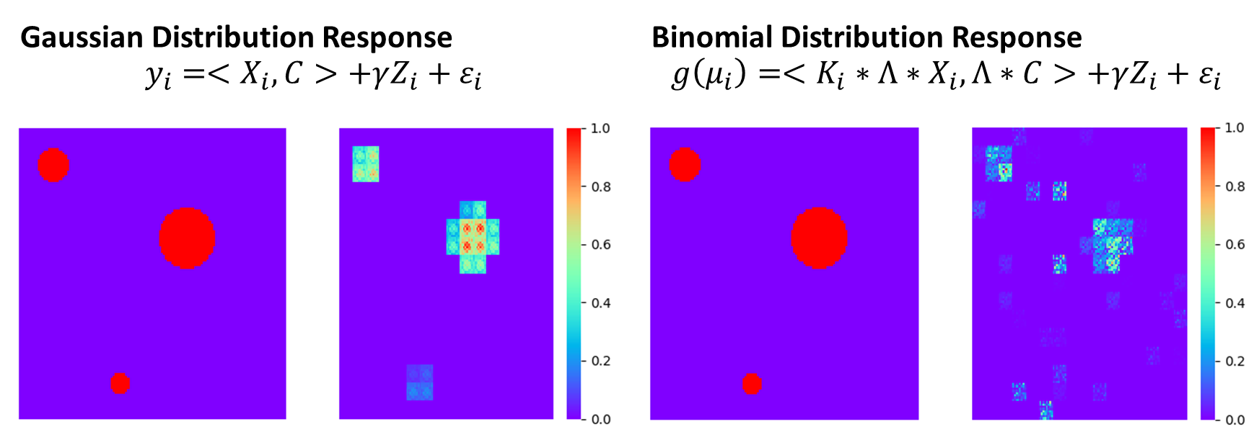
Simulation Example
Each was performed using 10,000 samples, takes more samples for the CSKPD case to converge
Both guaranteed to converge by the estimation consistency and region detection consistency from SKPD
SKPD is a special case of CSKPD when $g\left(μ\right)=μ, K=I, Λ=I$

Slide 10
Data Processing
Using OASIS-1 Dataset:
MRI medical imaging data set of brain scans of 436 Patients stored as medical imaging file
Each image file is 1-4 scans each of shape 256x256x128
Include important information of the medical scan as metadata: age, gender, brain volume
Includes MMSE Score used to measure whether a patient has Alzheimer’s (MMSE < 24)
Pre-Processing
Split scans into 2D slices: sagittal, coronal, and horizontal by taking random slices of the 3D tensor
Preprocessed with a Bilaterial Filter to remove salt and pepper noise
Resized to 96x96
Interpolated (Gaussian) to remove the blank space for each image
Projected onto each of the views
Post-Processing
The invertible nature of these convolutions make it difficult to determine the necessary data
Each $C$ matrix/tensor can be reconstructed using the deconvolution
Once the estimates for each model is determined a model of models can be formed providing similarities to the CNN
The invertible nature of these convolutions make it difficult to determine the necessary data
Each 𝐶 matrix/tensor can be reconstructed using the deconvolution
Once the estimates for each model is determined a model of models can be formed providing similarities to the CNN

Slide 11
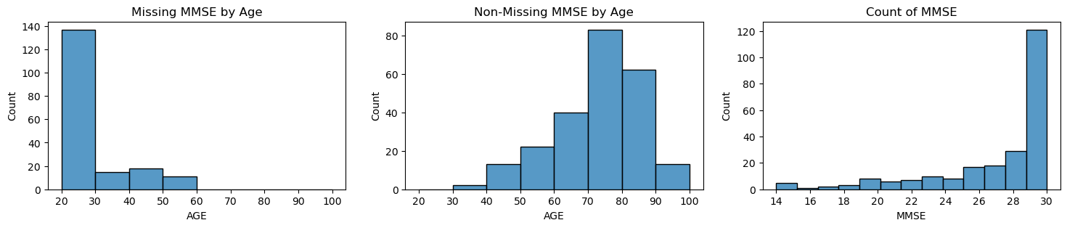
Statistics of the OASIS Data
Imputation
MMSE Score was missing for several younger patients (46% all under 60)
Three Options for imputation, used as a training hyperparameter:
The average MMSE score for those under 60 was 29.46
The cutoff point of Alzheimers: 24
Removal of missing values
Skew
The data is heavily skewed towards higher MMSE scores and non-demented patients.
80% of the patients with an MMSE score was greater than 24.

Slide 12


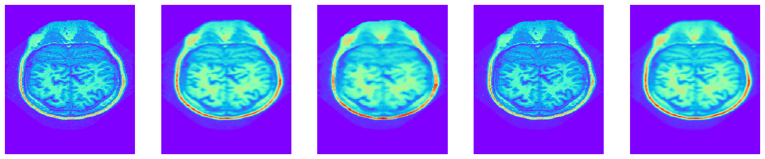
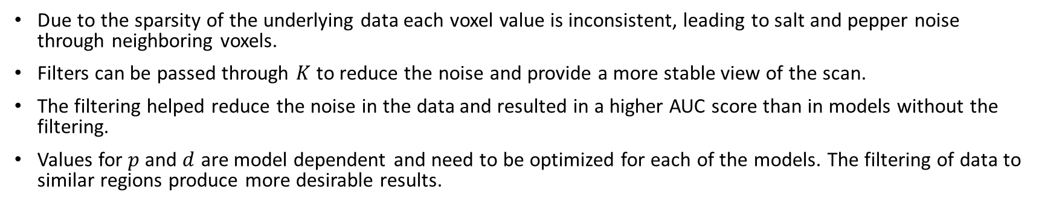
Issues with the Data
Due to the sparsity of the underlying data each voxel value is inconsistent, leading to salt and pepper noise through neighboring voxels.
Filters can be passed through $K$ to reduce the noise and provide a more stable view of the scan.
The filtering helped reduce the noise in the data and resulted in a higher AUC score than in models without the filtering.
Values for $p$ and $d$ are model dependent and need to be optimized for each of the models. The filtering of data to similar regions produce more desirable results.
Coronal View by Slice
Traversal View by Slice
Sagittal View
Unfiltered
Gaussian Blur
Median Blur
Bilateral
3D Gaussian

Slide 13
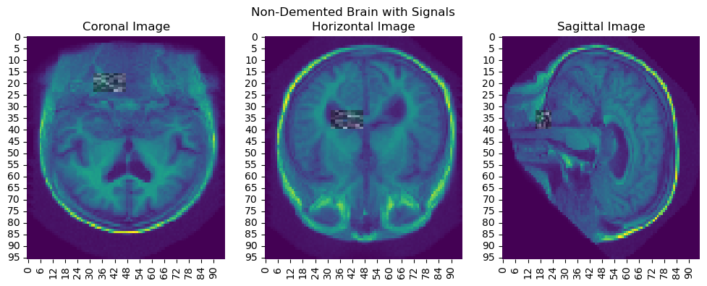
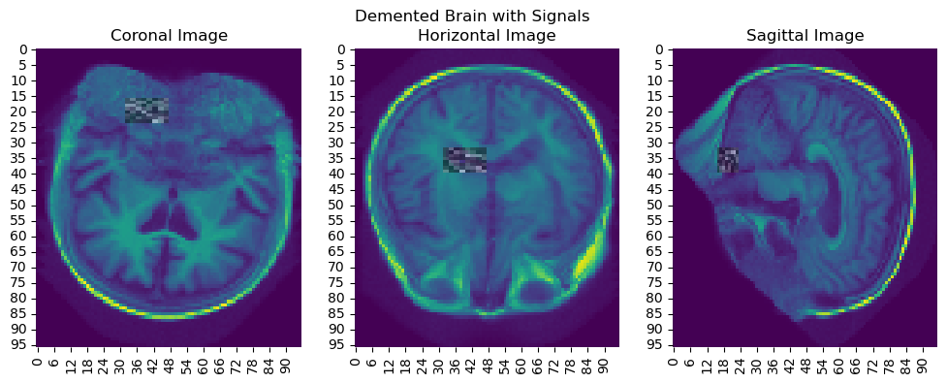
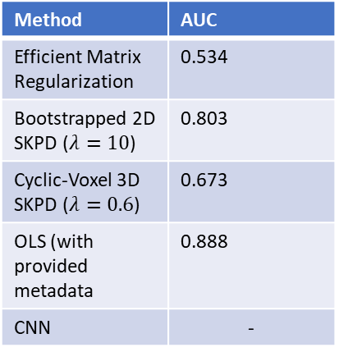
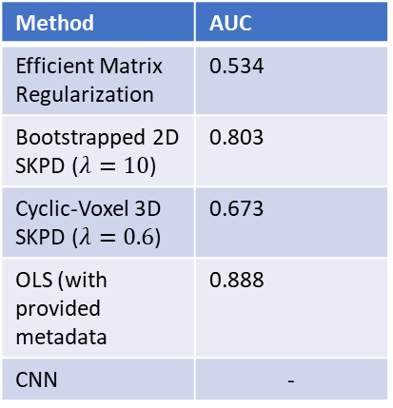
Results
To calculate the AUC a relu and softmax were used for SKPD and Cyclic-Voxel SKPD to convert the MMSE score to determine Alzheimer’s.
The AUC score and predictions from each of the models to create a model of models.
Performs similarly to other methods.
Provides the region impacting the overall results, that region can be reproduced using the CSKPD architecture.
Method | AUC
Efficient Matrix Regularization | 0.534
Bootstrapped 2D SKPD ($λ=10$) | 0.803
Cyclic-Voxel 3D SKPD ($λ=0.6$) | 0.673
OLS (with provided metadata | 0.888
CNN | -
Method | AUC
Efficient Matrix Regularization | 0.534
Bootstrapped 2D SKPD ($λ=10$) | 0.803
Cyclic-Voxel 3D SKPD ($λ=0.6$) | 0.673
OLS (with provided metadata | 0.888
CNN | -

Slide 14
Additional Work
Mathematical calculations for guarantees of the CSKPD extensions and convergence to CNN.
Optimize the hyperparameters to get more consistent and desirable results.
Consider Bayesian models for comparison and see if certain Bayesian components can be utilized to better assist in the accuracy and AUC for the model.
Apply to other datasets to see multi-modal and higher-dimensional capabilities of the model.

